Slide 1
PowerApps and Power Automate Training
By Visual Path
Trainer : Hemendra

Slide 2
About Me
8+ Years of Experience.
Microsoft Certified Trainer.
Microsoft Certified Developer.

Slide 3
Types of Developers
Citizen Developer (Low Code/No Code)
Professional Developer(Pro Code)

Slide 4
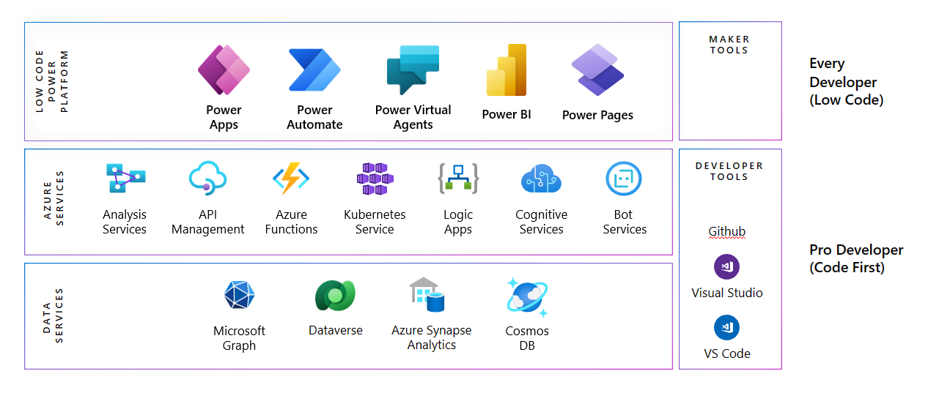

Slide 5
Popular Low Code Tools
Mendix.
OutSystem.
PowerPlatform.
Kissflow
Wix

Slide 6
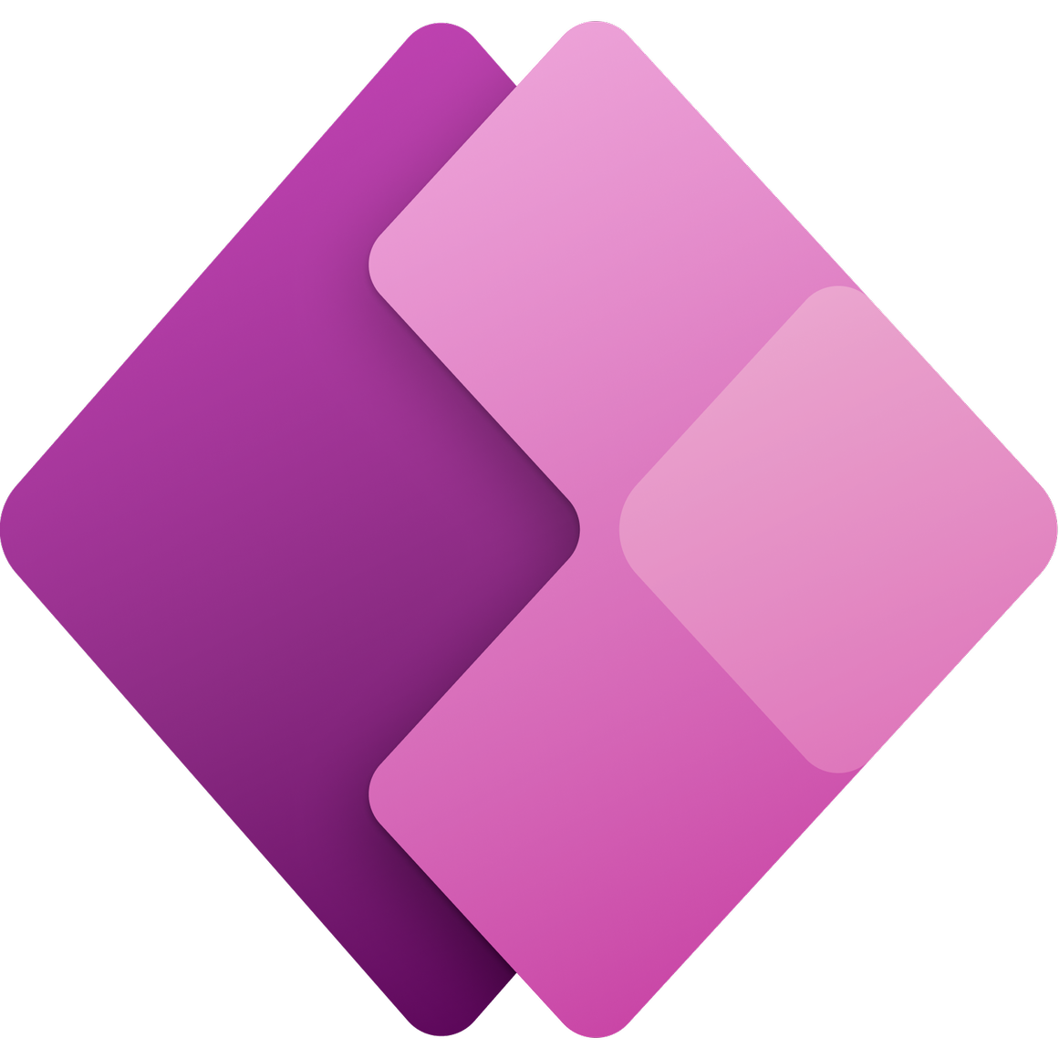


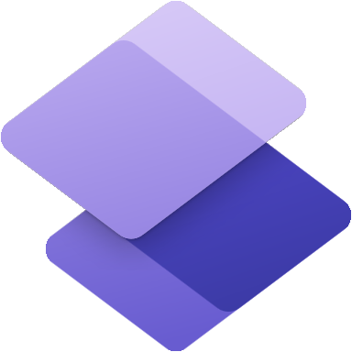
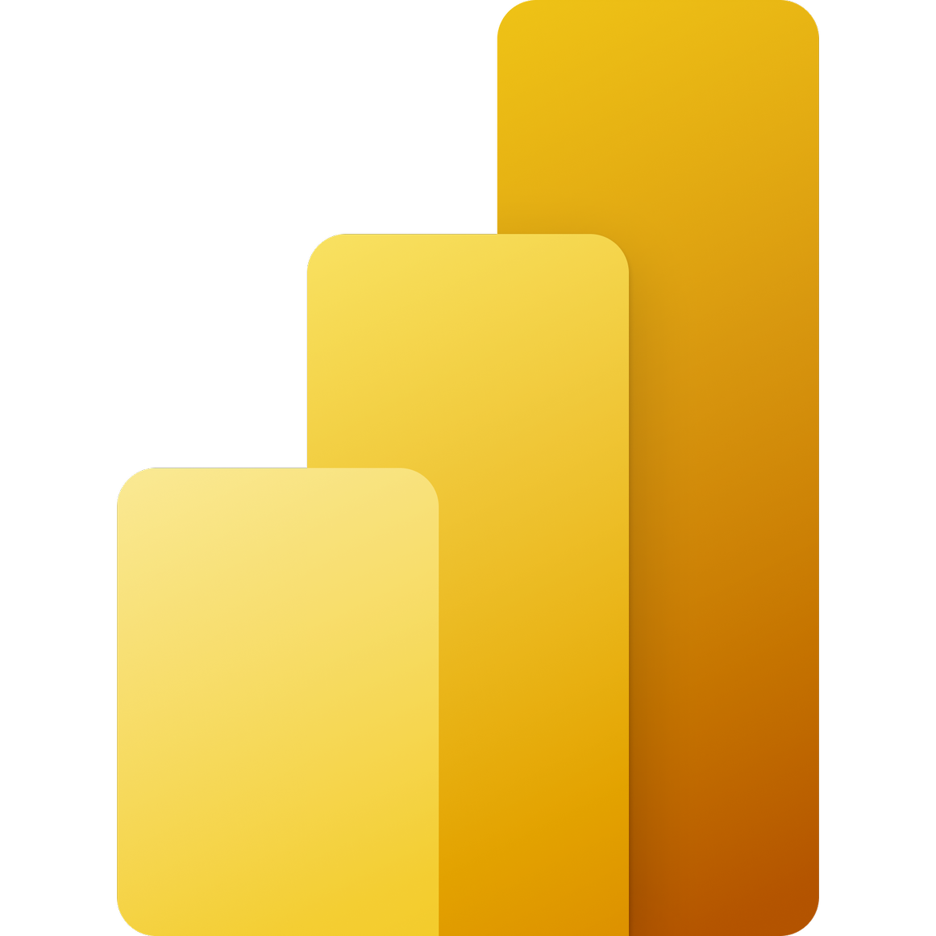
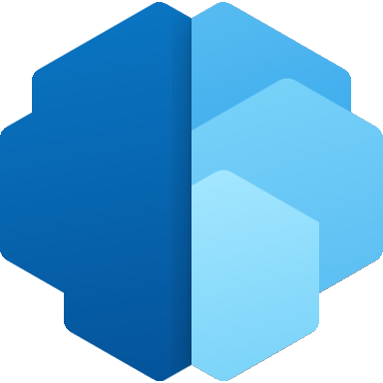

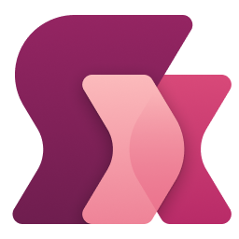

Microsoft Power Platform | Low Code Platform
The world’s most complete set of integrated, low-code development tools
Power Apps
Power Automate
Power Virtual Agents
Power Pages
Power BI
for web and mobile application development
for process or workflow automation
for chatbots and conversational agents
for
building secure, data-centric business websites
for data exploration, analytics and reporting
Data connectors
AI Builder
Microsoft Dataverse
Power Fx
Managed Environments

Slide 7
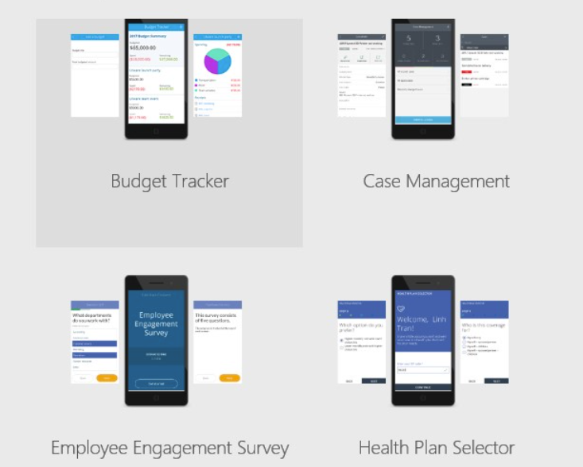
What is Power Apps?
Microsoft designed the Power Platform and Power Apps to let you build any business application based on your data.
Power Apps helps create custom applications that allow your team to efficiently communicate and share information.
Its highly intuitive interface was designed to allow as many people as possible to create unlimited apps.
Save time and resources on training and coding, while meeting your business needs with the most personalized solution.
Specifically, it allows you to create the app that best suits your needs with your own data source, with basic programming or app development skills.
Your custom applications can be fully linked to your Microsoft solutions or other IT tools already used in your business.

Slide 8
Types of Power Apps
Canvas Powerapps
Model-Driven Powerapps
Power Pages

Slide 9
URL
Power Apps

Slide 10
Office 365 Trail License
Microsoft 365 E3 | Microsoft 365 Enterprise

Slide 11
Learning resources
Microsoft Power Platform: Learning Resources | Microsoft Power Apps

